Slide 1


EXT JS ARCHITECTURE
By Group B

Slide 2
INTRODUCTION TO EXT JS
Ext JS is a powerful JavaScript framework for building large-scale web applications
It supports both MVC and MVVM architectures.
Ideal for enterprise-level applications requiring complex UIs and robust data handling.

Slide 3
EXT JS FRAMEWORK OVERVIEW
Components : Ext JS applications are composed of nested components.
Data Binding : Supports dynamic updates and reduces manual DOM manipulation.
Rapid Development : Tools like Sencha Cmd and Rapid Ext JS facilitate quick app development.

Slide 4
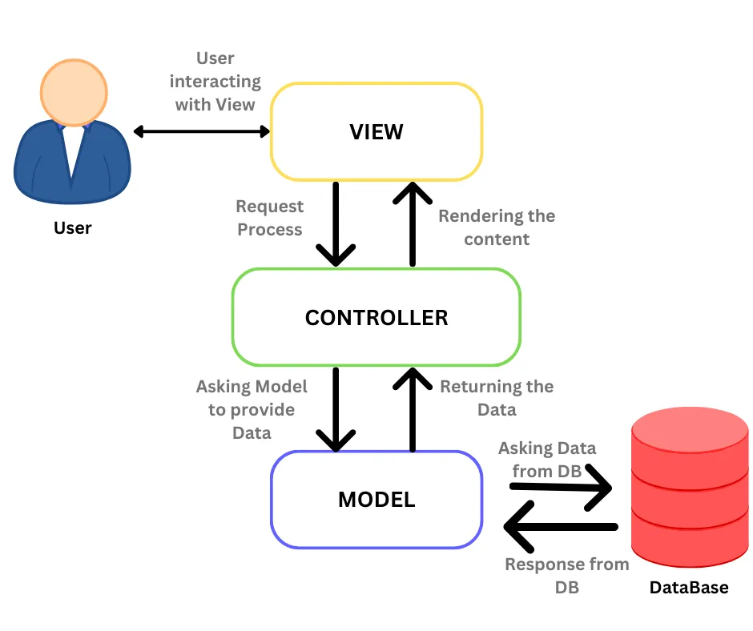
MVC ARCHITECTURE IN EXT JS
Model : Handles data and business logic.
View : Presents the UI.
Controller : Manages the interaction between Model and View.

Slide 5
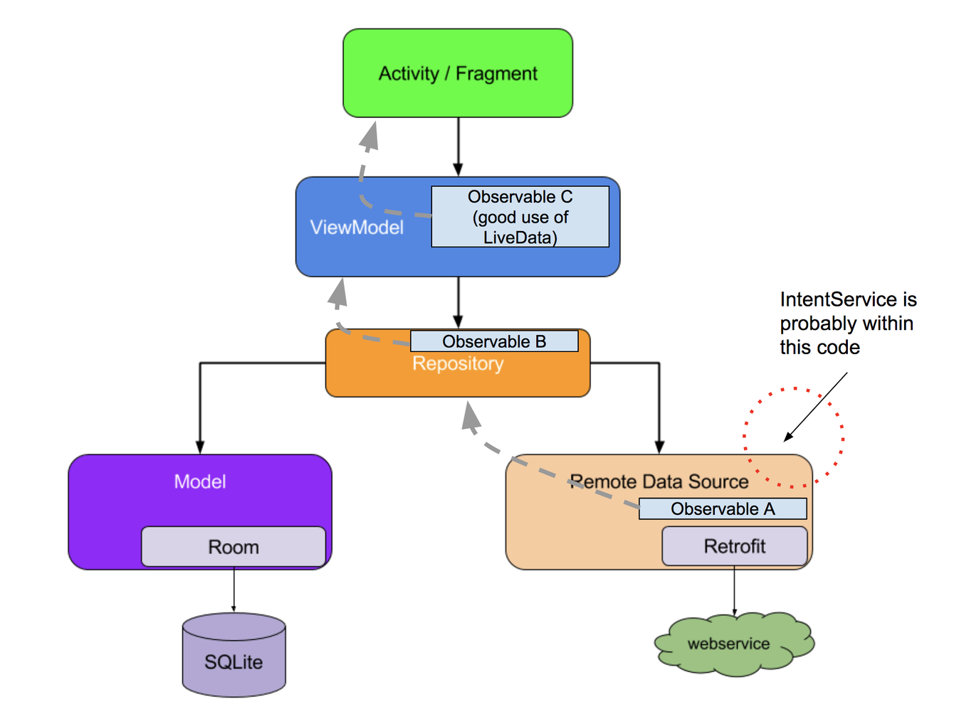
MVVM ARCHITECTURE IN EXT JS
Model : Handles data and business logic.
View : Presents the UI.
ViewModel: Acts as a bridge between the View and Model.
Supports data binding and simplifies UI logic.

Slide 6
BENEFITS OF MVVM IN EXT JS
Separation of Concerns: Business logic is separate from UI code.
Improved Testability: Easier unit testing of business logic.
Scalability and Maintainability: Supports application growth without losing structure.
Data Binding: Automatic updates reduce manual coding.

Slide 7
BEST PRACTICES FOR MVVM IN EXT JS
Set clear boundaries between components.
Leverage data binding.
Use ViewModels for logic.
Optimize performance with large datasets.
Document thoroughly.

Slide 8
CONCLUSION
Summary: Ext JS offers robust tools and architectures for building complex web applications efficiently.
Flexible architecture with MVC/MVVM support.
Powerful framework for building complex applications.
Call to Action: Explore Ext JS further for your next project.

Slide 9
THANK YOU

